Slide 1


Slide 2
Contents
Project Introduction
Literature Review
Methodology
Data Analysis & Interpretation
Conclusion
Styla Demonstration
Questions

Slide 3
Micro Celebrity
Fame
Narcissism
Need for Popularity
Social Anxiety
Popularity
Introduction

Slide 4

Literature

Slide 5
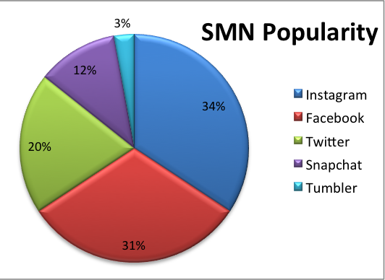
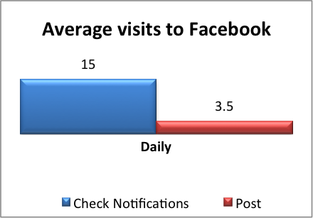
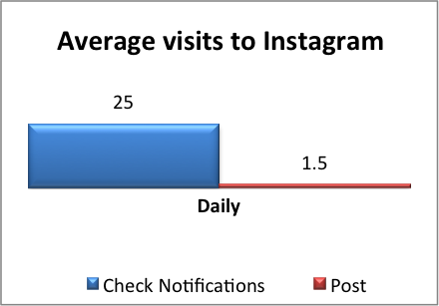
Data Analysis

Slide 6
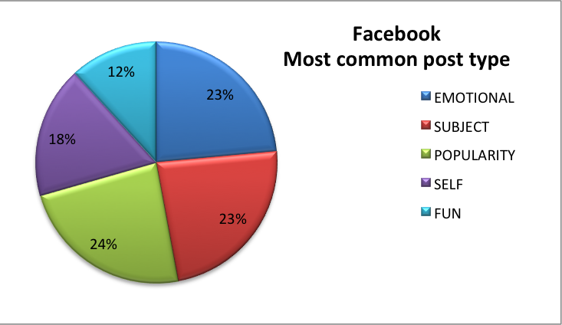
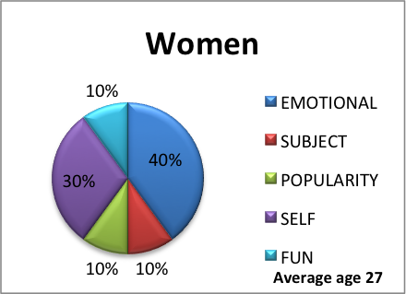
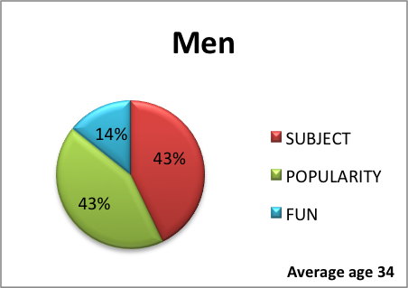
Data Analysis

Slide 7
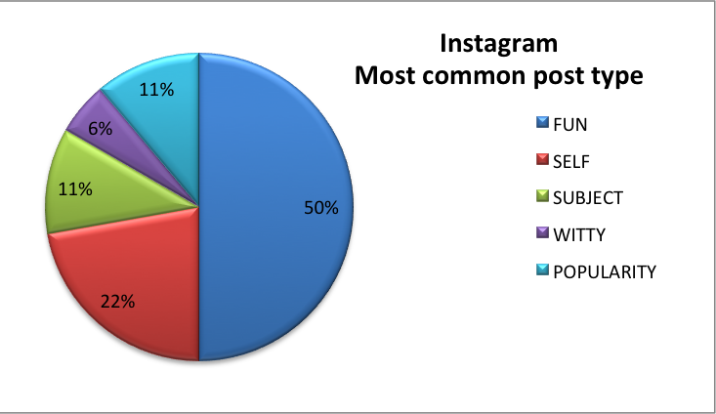
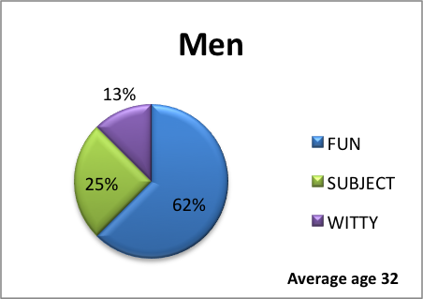
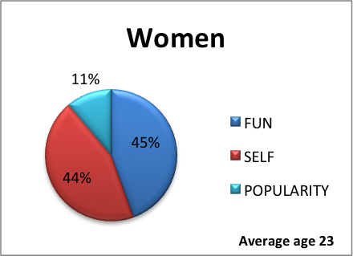
Data Analysis

Slide 8
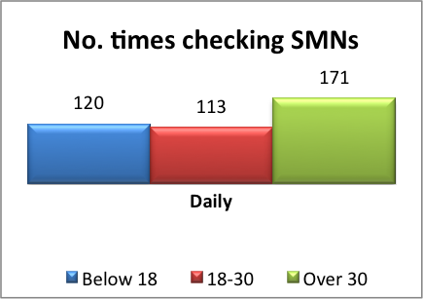
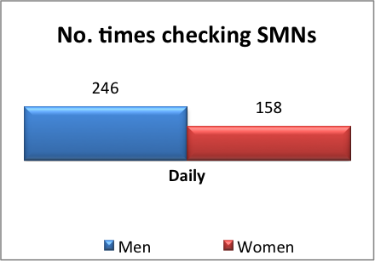
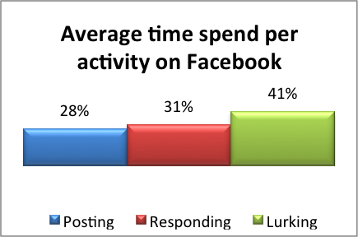
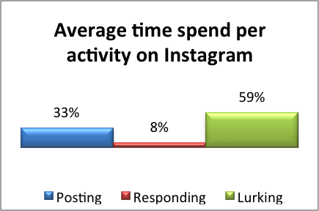
Data Analysis

Slide 9
Our findings suggest that there are 4 quite distinct groups of SMN users:
Socialites
Attention seekers
Lost & found
Entrepreneurs
Conclusion
Notes:
Socialites - with a majority of fun and witty posts have very high communications stats - people who used sites in intense short bursts to flirt, meet new people and entertainment.
Attention seekers - largest amount of self-posting - people who craved attention and comments from others, often by posting provocative photos of themselves.
Lost & found – with the majority of posts about their feelings and emotions - people that typically use SMNs to maintain old friendships and family connections.
Entrepreneurs - people who tended to be single-minded in using SMN sites.

Slide 10
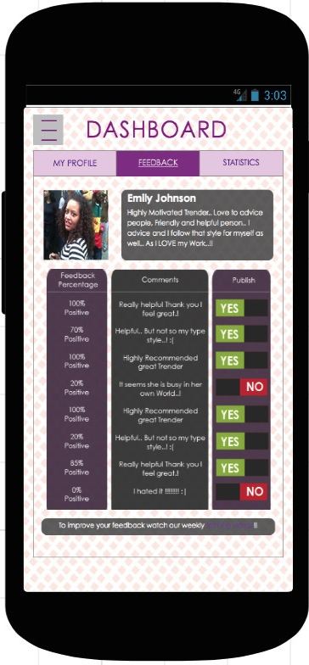
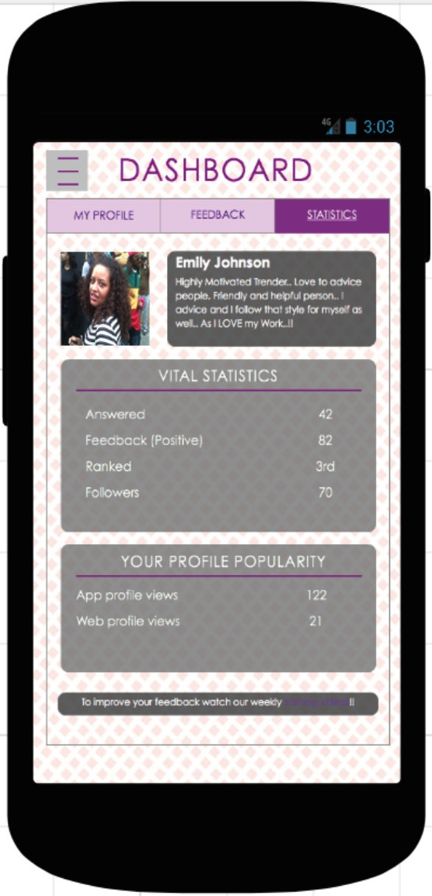
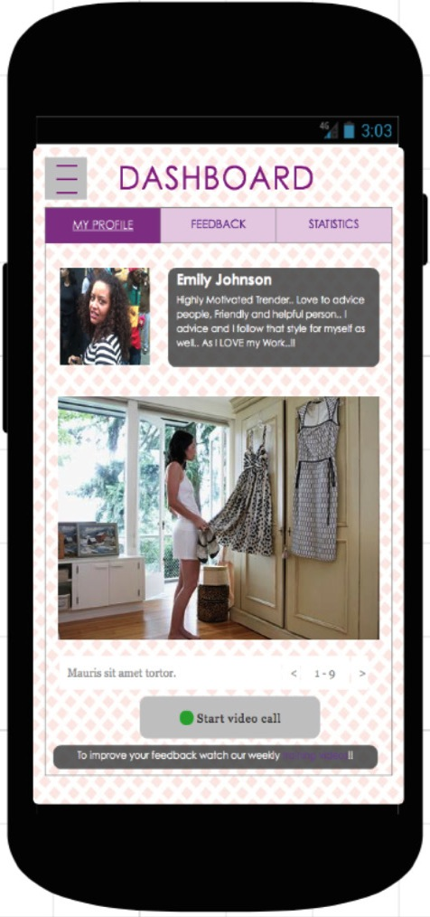
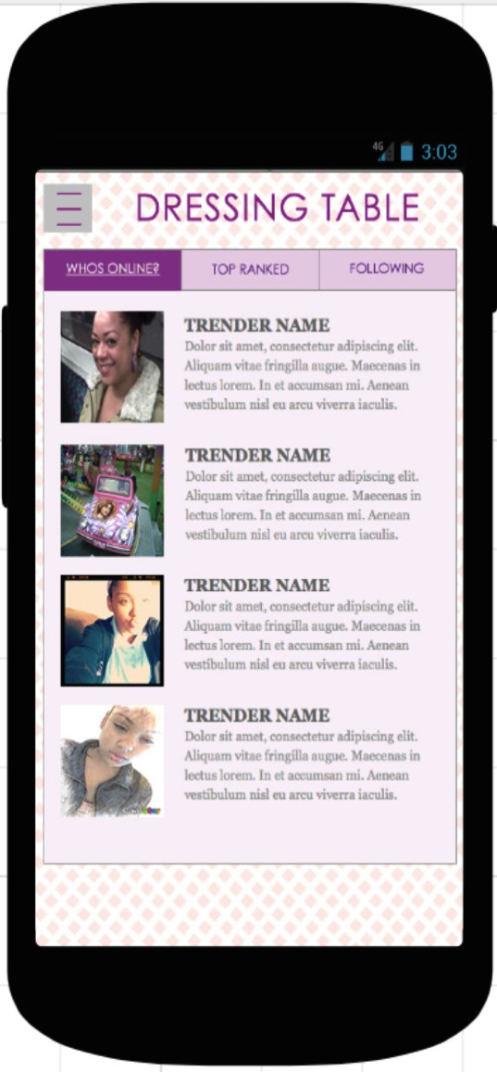



Styla
Notes:
Socialites - with a majority of fun and witty posts have very high communications stats - people who used sites in intense short bursts to flirt, meet new people and entertainment.
Attention seekers - largest amount of self-posting - people who craved attention and comments from others, often by posting provocative photos of themselves.
Lost & found – with the majority of posts about their feelings and emotions - people that typically use SMNs to maintain old friendships and family connections.
Entrepreneurs - people who tended to be single-minded in using SMN sites.

Slide 11
QUESTIONS?
Thank You
^{Available to download at:}
www.mypartstrader.com/styla/download

